Slide 1
Fulcrum Care
Supervision and The CQC
Matthew Adlem

Slide 2
Introduction
Fulcrum Care Services & Products
The Health and Social Care Act
The CQC Quality Statements
The Evidence Base
The NMC Code
The HCPC Code
Inspection Examples – Supervision through Inspection
Indicators of Poor Practice
Tools for Reflective practice
Conclusion
Resources
Future Reading

Slide 3
Fulcrum Impact 2023
260
Care Services Assisted
84
Providers Owning 676 Services Supported

Slide 4
Fulcrum Responsive 2023
32
Urgent Care Home Closures Averted
21
Independent Safeguarding Reviews for Care Homes & Hospitals
38
Embargoes Lifted

Slide 5
Fulcrum Proactive 2023
60
Operational DD’s for Banks & PE Firms
178
“CQC Readiness”
Audits

Slide 6
Fulcrum Value Add 2023
16
Operations-Focused Commercial Reviews to Optimise Performance
13
Homes under Fulcrum’s Outsourced Operations Management

Slide 7
The Health and Social Care Act
Regulation 18: Staffing
"Staff should receive appropriate ongoing or periodic supervision in their role to make sure competence is maintained. "
"Health, social and other care professionals must have access to clinical or professional supervision as required, in line with the requirements of the relevant professional regulator. "
Regulation 19: Fit and proper persons employed
"They must provide appropriate direct or indirect supervision until the person is assessed as competent to carry out the role. Competence may include the demonstration of a caring and compassionate approach. It is expected that providers that employ healthcare assistants and social care support workers should follow the Care Certificate standards to assess their competence. "

Slide 8
The CQC Quality Statements
SAFE: Safe and effective staffing Quality 'We statement'
We expect providers, commissioners and system leaders live up to this statement: "We make sure there are enough qualified, skilled and experienced people, who receive effective support, supervision and development. They work together effectively to provide safe care that meets people’s individual needs."
"Staff receive the support they need to deliver safe care. This includes supervision, appraisal and support to develop, improve services and where needed, professional revalidation."

Slide 9
The CQC Quality Statements
CARING: Workforce wellbeing and enablement 'We statement'
We expect providers, commissioners and system leaders live up to this statement: "We care about and promote the wellbeing of our staff, and we support and enable them to always deliver person centred care."
Staff are supported if they are struggling at work. This has a positive impact on the care they deliver to people.
Staff have easy access to personalised support that recognises the diversity of a workforce with proactive and reactive measures.
People are supported by staff who feel valued by their leaders and their colleagues. They have a sense of belonging and the ability to contribute to decision making.

Slide 10
The Evidence Base - one
The Nursing and Midwifery Order 2001 (SI 2002/253): the-nursing-and-midwifery-order-2001-consolidated-text.pdf
Health and Safety Exectutive: Advice for managers on mental ill health conditions: Stress at work - Advice for managers on mental ill health conditions - HSE
HCPC Standards of conduct, performance and ethics: Standards of conduct, performance and ethics |
HCPC Standards of continuing professional development: Standards of continuing professional development |
NMC The Code Professional standards of practice and behaviour for nurses, midwives and nursing associates: The Code: Professional standards of practice and behaviour for nurses, midwives and nursing associates - The Nursing and Midwifery Council

Slide 11
The Evidence Base - two
NMC Standards for competence for registered nurses: Standards for competence for registered nurses - The Nursing and Midwifery Council
RCN Professional development: Professional Development | Royal College of Nursing
Guidance - The Seven Principles of Public Life: The Seven Principles of Public Life - GOV.UK
The Royal Marsden Manual of Clinical Nursing Procedures page 132, "Clinical supervision can aid the transfer of communication skills into practice (Heaven et al 2006)"

Slide 12
The Evidence Base - three
The Royal Marsden Manual of Clinical Nursing Procedures page 137, "Principle: Consider the support needs of other people to whom you delegate tasks and your own support needs. If you or others are affected by any discussions you have had, seek discussion with supportive senior members of staff or consider debriefing and or / supervision. Rationale: Clinical supervision supports practice, enabling registered nurses to maintain and improve standards of care (NMC 2018)"

Slide 13
The NMC Code - one
Practise effectively: You assess need and deliver or advise on treatment, or give help (including preventative or rehabilitative care) without too much delay, to the best of your abilities, on the basis of best available evidence. You communicate effectively, keeping clear and accurate records and sharing skills, knowledge and experience where appropriate. You reflect and act on any feedback you receive to improve your practice.
9.4 support students’ and colleagues’ learning to help them develop their professional competence and confidence
11.2 make sure that everyone you delegate tasks to is adequately supervised and supported so they can provide safe and compassionate care

Slide 14
The NMC Code - two
Preserve safety: You make sure that patient and public safety is not affected. You work within the limits of your competence, exercising your professional ‘duty of candour’1and raising concerns immediately whenever you come across situations that put patients or public safety at risk. You take necessary action to deal with any concerns where appropriate.
13.3 ask for help from a suitably qualified and experienced professional to carry out any action or procedure that is beyond the limits of your competence

Slide 15
The NMC Code - three
Promote professionalism and trust: You uphold the reputation of your profession at all times. You should display a personal commitment to the standards of practice and behaviour set out in the Code. You should be a model of integrity and leadership for others to aspire to. This should lead to trust and confidence in the professions from patients, people receiving care, other health and care professionals and the public
22.3 keep your knowledge and skills up to date, taking part in appropriate and regular learning and professional development activities that aim to maintain and develop your competence and improve your performance

Slide 16
The NMC Revalidation
NMC GUIDANCE SHEET REFLECTIVE PRACTICE
"For revalidation you need to reflect as an individual and with one other person on our register. In addition, having reflective discussions at regular intervals throughout your renewal period, and with a number of different people (including as part of a group), makes reflection more meaningful"
reflective-practice-guidance.pdf

Slide 17
The HCPC Revalidation
Appendix 2: Examples of evidence This list should give you an idea of the kinds of evidence of your CPD you could provide. (This list has been adapted from work done by the Allied Health Professions’ project ‘Demonstrating competence through CPD’ (2003).)
Materials showing you have reflected on and evaluated your learning and work. Adapted documents arising from appraisals, supervision reviews and so on.
continuing-professional-development-and-your-registration.pdf

Slide 18
HCPC Code - one
4. Delegate appropriately Delegation, oversight and support
4.1 You must only delegate work to someone who has the knowledge, skills and experience needed to carry it out safely and effectively. 4.2 You must continue to provide appropriate supervision and support to those you delegate work to.

Slide 19
Supervision through CQC inspection - one
Safe and effective staffing
Score: 2
Inspection date: 30 July 2024

Slide 20
Supervision through CQC inspection - two
Safe and effective staffing
Score: 3
Inspection date: 26 April 2024

Slide 21
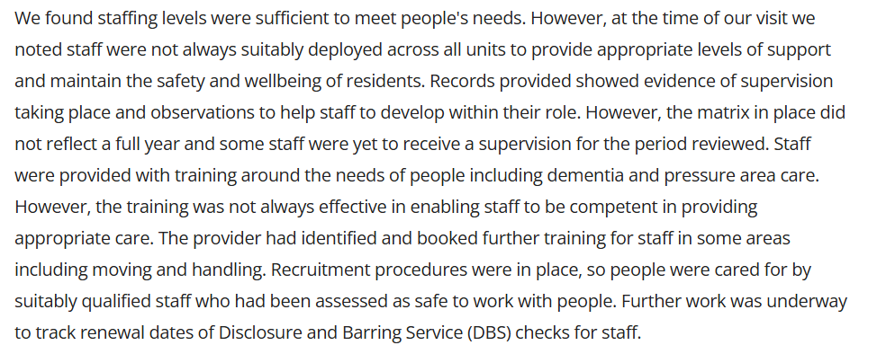
Supervision through CQC inspection - three
Safe and effective staffing
Score: 2
Inspection date: 12 July 2024

Slide 22
Supervision through CQC inspection - four
Safe and effective staffing
Score: 4
Inspection date: 3 May 2024

Slide 23
Indicators of poor practice
Poor care outcomes
Poor clinical standards
Whistleblowing, Freedom to speak up, Professional Nurse Advocate
Complaints, Negative feedback, and Safeguarding
Low morale, or high employee turn over
Employee onboarding and induction experience
Lessons learned / shared and candour
Governance and Well-led

Slide 24
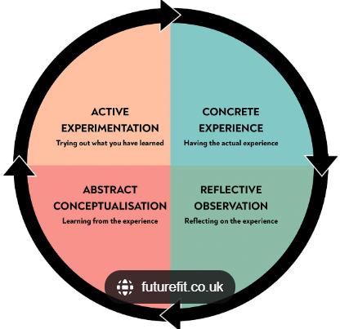
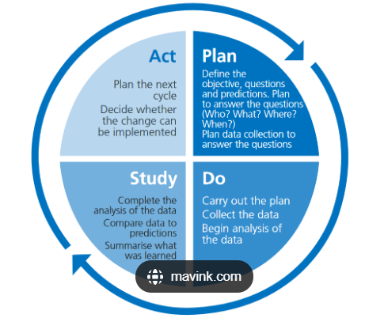
Tools for Reflective Practice

Slide 25
Conclusion
Supervision is a pathway to enable the continuous reflection and development of our own and our peer's professional development. It is present through the codes of practice for all health professionals.
The use of supervision can be applied through a variety of pathways, group, managerial, clinical, competency-focused or resilience based to name a few.
The regulator wants you to demonstrate how you utilise supervision to benefit employees working alongside you and people receiving care and treatment through your service.

Slide 26
Resources:
CQC Document: Guidance for Providers on meeting the regulations: Guidance for providers on meeting the regulations
CQC Single Assessment Framework: Safe and effective staffing - Care Quality Commission
PDSA NHS England: learning-handbook-pdsa.pdf
HEE Kolb learning cycle: Kolb learning cycle.pdf
Gibbs Reflective cycle: Gibbs' Reflective Cycle | The University of Edinburgh

Slide 27
Further Reading
Nursing Times: A new model of reflection for clinical practice | Nursing Times
NHS Professionals: Clinical Supervision | NHS Professionals
NATH: Clinical Supervision Resources | Nottinghamshire Alliance Training Hub (NATH)
NHS England: NHS England » Supervision guidance for primary care network multidisciplinary teams
RCN: RCN position on clinical supervision | Royal College of Nursing
The Christie NHS Foundation Trust: Clinical Supervision | The Christie NHS Foundation Trust

